Slide 1
Arrays and Strings(cont.)
DSA I
SY (COMP) COEP

Slide 2
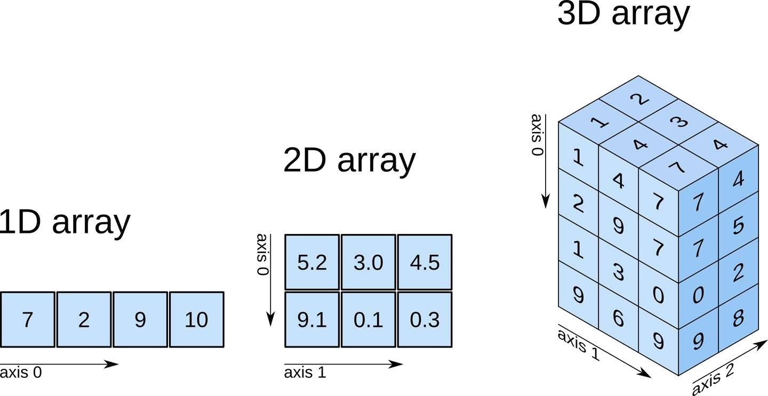
Pictorial representation

Slide 3


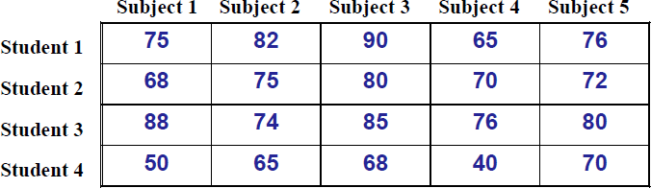
Two Dimensional Arrays
We have seen that an array variable can store a list of values.
Many applications require us to store a table of values.
The table contains a total of 20 values, five in each line.
– The table can be regarded as a matrix consisting of
four rows and five columns.
C allows us to define such tables of items by using two-dimensional arrays.

Slide 4

Declaring 2-D Arrays
In 2-dimentional array, elements are arranged in row and column format.
Array having more than one subscript variable/index is
called multidimensional array.
Multidimensional array is also called as matrix. General form:
type array_name [row_size][column_size];
Examples:
int marks[4][5]; float sales[12][25];
// 4 rows 5 column
// 12 rows 25 columns
double matrix[100][100]; // 100 rows 100 column

Slide 5
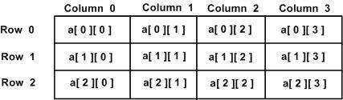
Declaring 2-D Arrays
A two-dimensional array a, which contains three rows and four columns can be shown as follows −
int a[3][4];
Thus, every element in the array a is identified by an element name of the form a[ i ][ j ], where 'a' is the name of the array, and 'i' and 'j' are the subscripts/indices that uniquely identify each element in 'a'.

Slide 6

Initializing Elements of a 2-D Array
Similar to that for 1-D array, but use two indices/subscripts.
First indicates row, second indicates column.
Both the indices should be integer constant greater than 0 or
expressions which evaluate to integer values.
Examples:
x[7][3] = 0;
c[i][k] = a[i][j] * b[j][k]; a = sqrt (a[j*3][k]);

Slide 7
Initialization:
int stud[2][4] = { 1234, 56, 1212, 33, 1434, 80, 1312, 78 } ;
All values are assigned sequentially and row-wise.

Slide 8
Initializing Elements of a 2-D Array
Multidimensional arrays may be initialized by specifying bracketed values for each row.
int stud[4][2] = {
{ 1234, 56 },
{ 1212, 33 },
{ 1434, 80 },
{ 1312, 78 }
} ;

Slide 9
Initializing and Accessing Elements of a 2-D Array
#include <stdio.h> Output :
int main() {
int i, j;
int a[3][2] = { 1, 4, 5, 2, 6, 5 };
/* or you can initialize as int a[3][2] = { { 1, 4 },
{ 5, 2 },
{ 6, 5 }}; */
1 4
5 2
6 5
Note-
for(i=0;i<row,i++) {
for (i = 0; i < 3; i++) {
for (j = 0; j < 2; j++) printf("%d ", a[i][j]); printf("\n");
for(j=0;j<col,j++) { printf("%d",a[i][j]);
}
}
return 0;
}
}

Slide 10
Initializing Elements of a 2-D Array
It is important to remember that while initializing a 2-D array it is necessary to mention the second (column_size) dimension, whereas the first dimension (row_size) is optional.
Thus,
int arr[2][3] = { 12, 34, 23, 45, 56, 45 } ;
int arr[ ][3] = { 12, 34, 23, 45, 56, 45 } ;
are perfectly acceptable,
whereas,
int arr[2][ ] = { 12, 34, 23, 45, 56, 45 } ;
int arr[ ][ ] = { 12, 34, 23, 45, 56, 45 } ;
would never work.

Slide 11
Accessing Elements of a 2-D Array
An element in a two-dimensional array is accessed by using the subscripts, i.e., row index and column index of the array.
For example − int val = a[2][3];
It will take the element from the 2nd row and 3rd cloumn of the
array and assign its value to ‘val’ variable.

Slide 12
Accessing Elements of a 2-D Array
#include <stdio.h> }
int main ()
{
/* an array with 5 rows and 2 columns*/
int a[5][2] = { {0,0}, {1,2}, {2,4},
{3,6},{4,8}};
int i, j;
/* output each array element's value
*/
for ( i = 0; i < 5; i++ ) { for ( j = 0; j < 2; j++ )
printf("a[%d][%d] : %d\n", i, j,
a[i][j] );
}
return 0;
}
Output: a[0][0]: 0
a[0][1]: 0
a[1][0]: 1
a[1][1]: 2
a[2][0]: 2
a[2][1]: 4
a[3][0]: 3
a[3][1]: 6
a[4][0]: 4
a[4][1]: 8

Slide 13
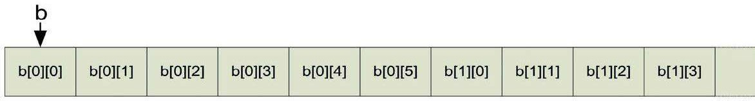
How is a 2-D array is stored in memory?
Starting from a given memory location, the elements are stored row-wise in consecutive memory locations.
x: starting address of the array in memory
c: number of columns
k: number of bytes allocated per array element
a[i][j] → is allocated memory location at address x + (i * c + j) * k

Slide 14
How to read the elements of a 2-D array?
By reading them one element at a time
for (i=0; i<nrow; i++) for (j=0; j<ncol; j++)
scanf (“%f”, &a[i][j]);
The ampersand (&) is necessary.
The elements can be entered all in one line or in different lines.

Slide 15
How to print the elements of a 2-D array?
By printing them one element at a time. for (i=0; i<nrow; i++)
for (j=0; j<ncol; j++)
printf (“\n %f”, a[i][j]);
– The elements are printed one per line.
1
2
3
.
.
for (i=0; i<nrow; i++) for (j=0; j<ncol; j++)
printf (“%f”, a[i][j]);
– The elements are all printed on the same line.
123456789

Slide 16
for (i=0; i<nrow; i++)
for (j=0; j<ncol; j++)
printf (“%f ”, a[i][j]);
printf (“\n”);
}
{
– The elements are printed nicely in matrix form.
1 | 2 | 3
4 | 5 | 6
7 | 8 | 9

Slide 17
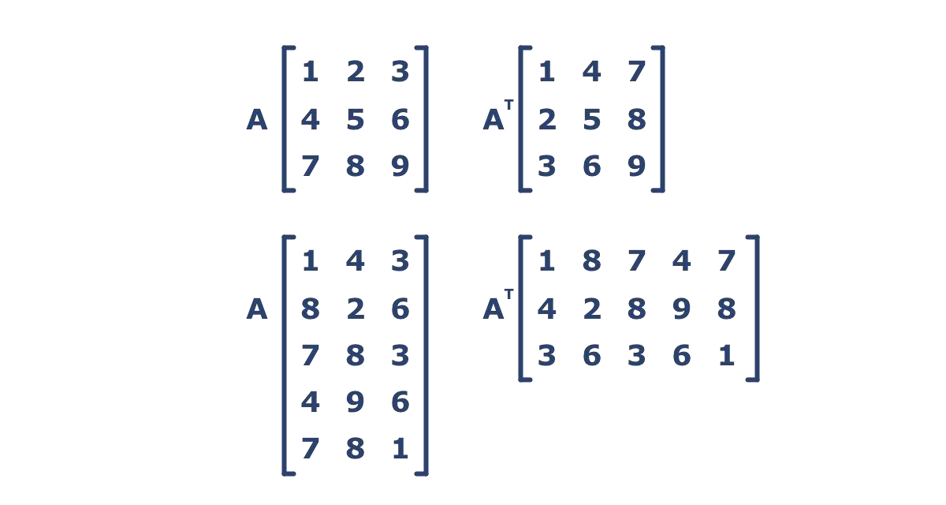
Operations on a 2D Matrix
Transpose

Slide 18
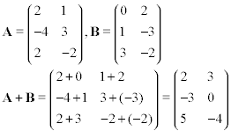
Example: Matrix Addition
Let A and B are two matrices of dimension M X N and S is the sum matrix(S =
A + B).
To add two matrices we have to add their corresponding elements. For example, S[i][j] = A[i][j] + B[i][j].
Traverse both matrices row wise(first all elements of a row, then jump to
next row) using two loops.
For every element A[i][j], add it with corresponding element B[i][j] and store the result in Sum matrix at S[i][j].

Slide 19
Example: Matrix Addition
#include <stdio.h> int main() {
int rows, cols, rowCounter, colCounter;
int firstmatrix[50][50], secondMatrix[50][50], sumMatrix[50][50]; printf("Enter Rows and Columns of Matrix\n");
scanf("%d %d", &rows, &cols);
printf("Enter first Matrix of size %dX%d\n", rows, cols);
/* Input first matrix*/
for(rowCounter = 0; rowCounter < rows; rowCounter++) {
for(colCounter = 0; colCounter < cols; colCounter++) { scanf("%d", &firstmatrix[rowCounter][colCounter]);
}
}

Slide 20
Example: Matrix Addition
/* Input second matrix*/
printf("Enter second Matrix of size %dX%d\n", rows, cols);
for(rowCounter = 0; rowCounter < rows; rowCounter++) {
for(colCounter = 0; colCounter < cols; colCounter++)
{
scanf("%d", &secondMatrix[rowCounter][colCounter]);
}
}
/* adding corresponding elements of both matrices sumMatrix[i][j] =
firstmatrix[i][j] + secondMatrix[i][j] */

Slide 21
Example: Matrix Addition
for(rowCounter = 0; rowCounter < rows; rowCounter++) { for(colCounter = 0; colCounter < cols; colCounter++) {
sumMatrix[rowCounter][colCounter] = firstmatrix[rowCounter][colCounter]
+ secondMatrix[rowCounter][colCounter];
}
}
printf("Sum Matrix\n");
for(rowCounter = 0; rowCounter < rows; rowCounter++) { for(colCounter = 0; colCounter < cols; colCounter++) {
printf("%d ", sumMatrix[rowCounter][colCounter]);
}
printf("\n");
}
return 0; }

Slide 22
Example: Matrix Multiplication
#include<stdio.h> int main() {
int a[50][50], b[50][50], c[50][50], i, j, k, sum = 0, m, n, o, p; printf("\nEnter the row and column of first matrix"); scanf("%d%d", &m, &n);
printf("\nEnter the row and column of second matrix");
scanf("%d %d", &o, &p); if(n != 0) {
printf("Matrix mutiplication is not possible");
printf("\nColumn of first matrix must be same as row of second matrix");
}

Slide 23
Matrix Multiplication (Cond..)
else
{
//Read the matrix form keyboard(user) printf("\nEnter the First matrix->"); for(i=0;i<m;i++)
for(j=0;j<n;j++)
scanf("%d",&a[i][j]);
printf("\nEnter the Second matrix->");
for(i=0;i<o;i++) for(j=0;j<p;j++)
scanf("%d",&b[i][j]);

Slide 24
Matrix Multiplication (Cond..)
//performing the matrix Multiplication
for(i = 0; i < m; i++) //row of first matrix
{
for(j = 0;j < p; j++)
{
sum=0;
//column of second matrix
for(k=0; k < n; k++) sum=sum + a[i][k] * b[k][j];
c[i][j] = sum;
}
}
}

Slide 25
Matrix Multiplication (Cond..)
//Display the matrix Multiplication printf("\nThe multiplication of two matrix is\n"); for(i = 0;i < m; i++) {
printf("\n");
for(j = 0; j < p; j++) { printf("%d\t",c[i][j]);
}
}
return 0;
}

Slide 26
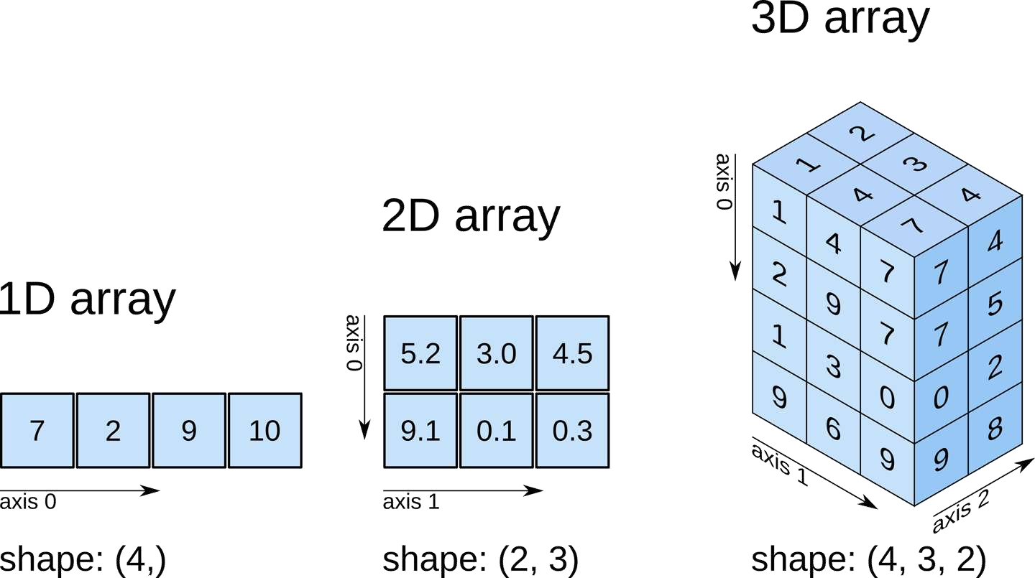
Multi –dimensional Array
eg:
Last 3 months sale each of Mobiles and Laptops of 4 outlets of Croma
Sale[4][3][2]

Slide 27
String (Character Array)
In C programming, the one-dimensional array of characters are called strings, which is terminated by a null character ‘\0.
Last character is always ‘\0’
because it is the only way the functions that work with a string can know where the string ends.
The ASCII value of null character('\0') is 0.
A string not terminated by a ‘\0’ is not really a string, but merely a collection of characters.
Note that for individual characters, C
whereas for strings, it uses double quotes.
For Example:
String constant : “CCourse"
Character constant: ‘C'
uses single quotes,

Slide 28
String Declaration in C
Syntax:
char string_name[SIZE_OF_STRING];
Examples:
char address[100];
char welcomeMessage[200]; char name[6];
Note- C Does not provide support for boundary checking i.e. if we store more characters than the specified size in string declaration then C compiler will not give you any error.
Remember, name of an array also specifies the base address of
an array.

Slide 29
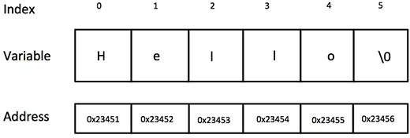
String Initialization in C
In C programming language, a string can be initialized at the time of declarations like any other variable in C. If we don't initialize an array then by default it will contain garbage value.
char message[6] = {‘H', ‘e', ‘l', ‘l', ‘o', '\0'};
or
char message[] = “Hello";
Note- In this type of initialization , we don’t need to put terminating null character at the end of string constant. C compiler will automatically inserts a null character('\0'), after the last character of the string literal.

Slide 30
String
#include<stdio.h> int main() {
char stringArray[100];
printf("Please write something: \n");
scanf("%s", stringArray);
//%s is a format specifier for string
// string declaration
printf("You entered the string %s \n", stringArray);
return 0;
}
Note- Array name is by default address of array, so & not needed for scanf.

Slide 31
Few Points on Strings
char str[]; // Invalid at declaration string size is must
char str[0]; // Invalid string size must not be -ve or zero value char str[-1]; // Invalid
char str[10]; // Valid
char str[2]={'5','+','A','B'}; // Invalid can not initialized more than size of string
char str[]={'5','+','A','B'}; // Valid In initialization of the string the size is optional

Slide 32
Few Points on Strings
– Each character of string is stored in consecutive memory
location and occupy 1 byte of memory.
– If string contains the double quote as part of string then we can
use escape character to keep double quote as a part of string.
“Co\"ep" is an example of String
char string1[] = "first";
string1 actually has 6 elements
It is equivalent to
char string1[] = { 'f', 'i', 'r', 's', 't', '\0' };
Can access individual characters
string1[ 3 ] is character ‘s’
If we don't specify the size of String then length is calculated automatically by the compiler. The length of the string will be one more than the number of characters in string literal/constant.

Slide 33

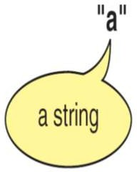
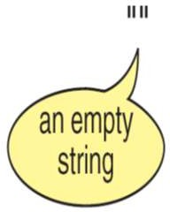

Slide 34
Display a String
void main( ) {
char name[ ] = “COEP" ; int i = 0 ;
while ( i <= 3 ) {
printf ( "%c", name[i] ) ; i++ ;
}
}
Note- printf( ) doesn’t print the ‘\0’.

Slide 35
Display a String
void main( ) {
char name[ ] = “COEP" ;
int i = 0 ;
while ( name[i] != `\0’ ) {
printf ( "%c", name[i] ) ; i++ ;
}
}

Slide 36
Input strings
Use scanf
char string2[4];
For reading individual characters
for(i=0;i<3;i++) scanf("%c",&string2[i]);
main( ) {
char name[10];
int i = 0 ; while ( i<9 ) {
scanf ( "%c", &name[i] ) ;
i++ ;
}
name[9]=‘\0’;
}

Slide 37
Input strings
Use scanf
char string2[4];
scanf( "%s", string2 );
Array name is address of array, so & not needed for scanf
main( ) {
char name[10]; int i = 0 ;
printf(“Enter your name”)
scanf ( "%s", name ) ;
printf(“%s”, name);
}

Slide 38
Inputting strings
While entering the string using scanf( ) we must be cautious about two things:
The length of the string should not exceed the dimension of the character array. This is because the C compiler doesn’t perform bounds checking on character arrays. Hence, if you carelessly exceed the bounds there is always a danger of overwriting something important.
scanf() is not capable of receiving multi-word strings. Therefore names such as ‘COEP COLLEGE’ would be unacceptable. The way to get around this limitation is by using the function gets( ).

Slide 39
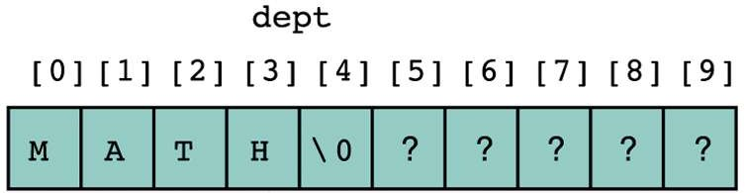
Execution of scanf ("%s", dept);
Whenever encountering a white space, the scanning stops and scanf places the null character at the end of the string.
e.g., if the user types “MATH 1234 TR 1800,” the string
“MATH” along with ‘\0’ is stored into dept[].

Slide 40
strings using gets() and puts()
void main( ) {
char name[10]; int i = 0 ;
printf(“Enter name”)
gets(name) ;
puts(“hello!”);
puts(name);
}
Enter Name COEP COLLEGE
hello!
COEP COLLEGE
//scanf(“%[^\n]s”, name);
// printf(“hello!\n%s”, name);

Slide 41
strings using gets() and puts()
puts( ) can display only one string at a time.
Also, on displaying a string, unlike printf( ), puts( ) places the
cursor on the next line.
gets( ) can receive a multi-word string.
gets( ) and puts( ) are available in stdio.h header file

Slide 42
String Handling Standard Library Function
C supports a wide range of functions that manipulate null- terminated strings.
The string can not be copied by the assignment operator
‘=’.
– e..g, str = “Test String” is not valid.
C provides string manipulating functions in the “string.h”
header file.

Slide 43
Some String Functions from string.h
Function Purpose Example
strcpy()
strcpy(s1, s2); strcpy(s1, “Hi”);
Copies string s2 into string s1.
strcat()
strcat(s1, s2);
Appends a string s2 to the end of another string s1.
strcat(s1, “more”);
strcmp()
strcmp(s1, s2);
Returns 0 if s1 and s2 are the same; less than 0 if s1<s2; greater than 0 if s1>s2.
Compares two strings character by
character.
strcmp(s1, “Hi”);

Slide 44
Some String Functions from string.h
Function Purpose Example
strlen()
Returns the number of characters in strlen(“Hi”)
a string. returns 2.
^{strchr()} strchr(s1, ch);
It searches for the first occurrence of a character ch in the string s1.
^{strstr()} strstr(s1, s2);
It searches for the first occurrence of a string s2 in another string s1.

Slide 45
strcpy
Function strcpy copies the second string (source) into the first string (destination).
strcpy(destination, source)
e.g., strcpy(dest, “test string”);
The null character is appended at the end automatically.
strcpy( ) goes on copying the characters in source string into the
target string till it doesn't encounter the end of source string (‘\0’).
If source string is longer than the destination string, the overflow characters may occupy the memory space used by other variables.
to copy str2 to str1: char str1[20];
char str2[]=“coep”;
strcpy(str1, str2);
str1 = str2; /* Will NOT work!! */

Slide 46
Example
#include<string.h> void main( ) {
char source[ ] = "Sayonara" ;
char target[20] ; strcpy ( target, source ) ;
printf ( "\nsource string = %s", source ) ;
printf ( "\ntarget string = %s", target ) ;
}
}
The output would be... source string = Sayonara target string = Sayonara

Slide 47
strcat
This function concatenates the source string at the end of the target string. (without space)
– strcat(target,source);
to add (concatenate) str2 to the end of str1:
char str1[]=”coep”;
char str2[]=“pune”;
strcat(str1, str2);
returns the value of str1 with str2 added to the end
– Make sure that str1 has room for str2
str1 becomes “coeppune”

Slide 48
Example
#include<string.h> void main( ) {
char source[ ] = "Folks!" ;
char target[30] = "Hello" ; strcat ( target, source ) ;
printf ( "\nsource string = %s", source ) ;
printf ( "\ntarget string = %s", target ) ;
}
The output would be...
source string = Folks! target string = HelloFolks!

Slide 49
Finding the Length of a String
Use strlen(string)
– returns length of the string
This function counts the number of characters present in a string.
Function strlen is often used to check the length of a string (i.e., the number of characters before the null character).
char dest[6] = “Hello”;
i=strlen(dest); i=5

Slide 50
Example
#include<string.h> void main( )
{
char arr[ ] = “COEP" ;
int len1, len2 ;
len1 = strlen ( arr ) ;
len2 = strlen ( "Humpty Dumpty" ) ;
printf ( "\nstring = %s length = %d", arr, len1 ) ;
printf ( "\nstring = %s length = %d", "Humpty Dumpty", len2 ) ;
}
The output would be... string = COEP length = 4
string = Humpty Dumpty length = 13

Slide 51
String Comparison (1/2)
strcmp(string1, string2 )
The comparison between two strings is done by comparing
each corresponding character in them.
The two strings are compared character by character until there is a mismatch or end of one of the strings is reached, whichever occurs first.
If the two strings are identical, strcmp( ) returns a value zero. If they’re not, it returns the numeric difference between the ASCII values of the first non-matching pairs of characters.
“thrill” < “throw” since ‘i’ < ‘o’;
“joy” < joyous“;

Slide 52
String Comparison (2/2)
Relationship | Returned Value | Example
str1 < str2 | Negative | “Hello”< “Hi”
str1 == str2 | 0 | “Hi” = “Hi”
str1 > str2 | Positive | “Hi” > “Hello”
e.g., we can check if two strings are the same by char str1[]=“coep”; char str2[]=“pune”; if(strcmp(str1, str2) != 0)
printf(“The two strings are different!”);

Slide 53
Example
#include<string.h> void main( )
{
char string1[ ] = "Jerry" ; char string2[ ] = "Ferry" ;
int i, j, k ;
i = strcmp ( string1, "Jerry" ) ; j = strcmp ( string1, string2 ) ;
k = strcmp ( string1, "Jerry boy" ) ; printf ( "\n%d %d %d", i, j, k ) ;
}
The output would be...
0 4 -32

Slide 54
Example
#include <stdio.h> #include <string.h> int main ()
{
char str1[12] = "Hello";
char str2[12] = "World"; char str3[12];
int len ;
/* copy str1 into str3 */ strcpy(str3, str1);
printf("strcpy( str3, str1) : %s\n", str3 );

Slide 55
Example
/* concatenates str1 and str2 */ strcat( str1, str2);
printf("strcat( str1, str2): %s\n", str1 );
/* total lenghth of str1 after concatenation */ len = strlen(str1);
printf("strlen(str1) : %d\n", len );
return 0;
}
strcpy( str3, str1) : Hello strcat( str1, str2): HelloWorld strlen(str1) : 10

Slide 56

Review
Character array
Declaration of Character Array Input
for(i=0;i<4;i++)
scanf("%c“,&name[i]); scanf(“%s”,name); not read space
gets(name); read the space
scanf(“%[^\n]s”, name); read the space also
Output
printf(“%s”,name);
for(i=0;i<4;i++)
print("%c",name[i]);
–String Library functions (strcpy, strcat, strlen, strcmp)

Slide 57
what is the o/p of following code?
void main( ) {
char name[ ] = “College" ;
int i = 0 ,n;
//n=strlen(name);
while ( name[i] != `\0’ ) { //while(i<n)
printf ( "%c", name[i] ) ; i++ ;
}
}

Slide 58
what is the o/p of following code?
void main( ) {
char name[25] ;
printf ( "Enter your full name " ) ;
gets ( name ) ;//scanf(“%[^\n]s”,name); printf( "Hello!" ) ;
printf(“%s”,name ) ;
}

Slide 59
What does this program do
void main() { char s[20]; int i,j,k,m;
printf(“Enter a sentence”);
gets(s);
printf(“Enter position and no of charactor”); scanf(“%d%d”,&i,&j);
for(k=0;s[k]!='\0';k++) {
if(k==i-1) {
for(m=k;m<i+j-1;m++) printf("%c",s[m]);
}
}
}

Slide 60
Same program with little modification
void main() { char s[20]; int i,j,k;
printf(“Enter a sentence”);
gets(s);
printf(“Enter position and no of charactor”); scanf(“%d%d”,&i,&j);
k=i;
while(k<j+i) { printf("%c",s[k-1]); k++;
}
}
It made our code simpler

